Slide 1

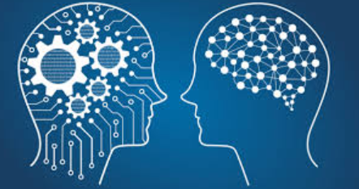
Artificial Intelligence

Slide 2
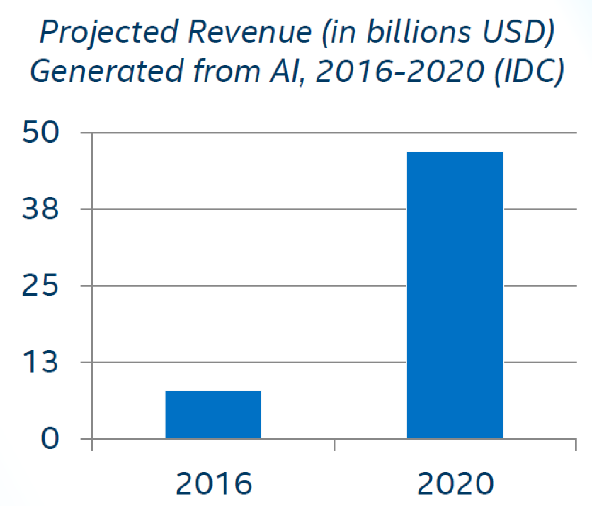
AI is The New Electricity
“About 100 years ago, electricity transformed every major industry. AI has advanced to the point where it has the power to transform…every major sector in coming years.”
-Andrew Ng, Stanford University

Slide 3
Artificial Intelligence
Humans have developed the power of computer systems in terms of their diverse working domains, their increasing speed, and reducing size with respect to time.
A branch of Computer Science named Artificial Intelligence pursues creating the computers or machines as intelligent as human beings.
-OR-
“A branch of computer science dealing with the simulation of intelligent behavior in computers.”
“A program that can sense, reason, act, and adapt.”

Slide 4
Artificial Intelligence
According to the father of Artificial Intelligence, John McCarthy, it is “The science and engineering of making intelligent machines, especially intelligent computer programs”.
Artificial Intelligence is a way of making a computer, a computer-controlled robot, or a software think intelligently, in the similar manner the intelligent humans think.
“Colloquially, the term ‘artificial intelligence’ is applied when a machine mimics ‘cognitive’ functions that humans associate with other human minds, such as ‘learning' and ‘problem solving’.”

Slide 5


Artificial intelligence - Philosophy While exploiting the power of the computer systems, the curiosity of human, lead him to wonder, “Can a machine think and behave like humans do?” Thus, the development of AI started with the intention of creating similar intelligence in machines that we find and regard high in humans.
1950 - “Turing Test” by Alan Turing
1956’s - “Artificial intelligence” by John McCarthy

Slide 6
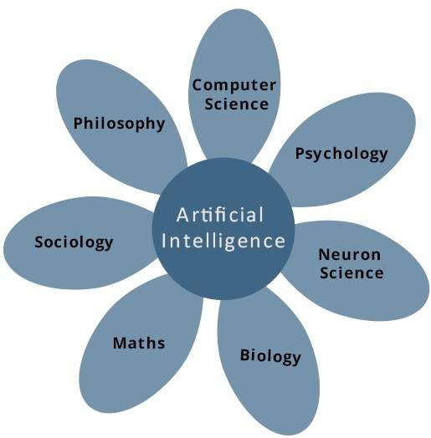
What Contributes to AI?

Slide 7
Programming Without and With AI
Programming Without AI | Programming With AI
A computer program without AI can answer the specific questions it is meant to solve. | A computer program with AI can answer the generic questions it is meant to solve.
Modification in the program leads to change in its structure. | AI programs can absorb new modifications by putting highly independent pieces of information together. Hence you can modify even a minute piece of information of program without affecting its structure.
Modification is not quick and easy. It may lead to affecting the program adversely. | Quick and Easy program modification.

Slide 8
Applications of AI
Gaming − AI plays crucial role in strategic games such as chess, poker, tic-tac-toe, etc., where machine can think of large number of possible positions based on heuristic knowledge.
Natural Language Processing − It is possible to interact with the computer that understands natural language spoken by humans.
Expert Systems − There are some applications which integrate machine, software, and special information to impart reasoning and advising. They provide explanation and advice to the users.
Vision Systems − These systems understand, interpret, and comprehend visual input on the computer. For example,
A spying aeroplane takes photographs, which are used to figure out spatial information or map of the areas.
Doctors use clinical expert system to diagnose the patient.
Police use computer software that can recognize the face of criminal with the stored portrait made by forensic artist.

Slide 9
Applications of AI
Speech Recognition − Some intelligent systems are capable of hearing and comprehending the language in terms of sentences and their meanings while a human talks to it. It can handle different accents, slang words, noise in the background, change in human’s noise due to cold, etc.
Handwriting Recognition − The handwriting recognition software reads the text written on paper by a pen or on screen by a stylus. It can recognize the shapes of the letters and convert it into editable text.
Intelligent Robots − Robots are able to perform the tasks given by a human. They have sensors to detect physical data from the real world such as light, heat, temperature, movement, sound, bump, and pressure. They have efficient processors, multiple sensors and huge memory, to exhibit intelligence. In addition, they are capable of learning from their mistakes and they can adapt to the new environment.

Slide 10
History
AI

Slide 11
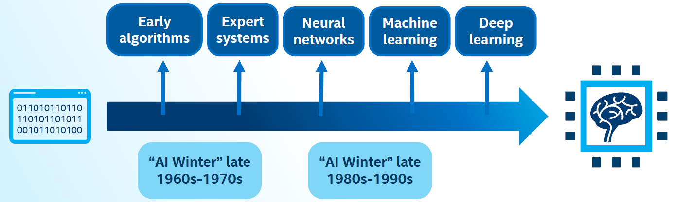
History of AI
AI has experienced several hype cycles, where it has oscillated between periods of excitement and disappointment.

Slide 12
1950s: Early AI
Alan Turing developed the Turing test to test a machines ability to exhibit intelligent behavior.
Frank Rosenblatt invented the perceptron algorithm. This was the precursor to modern neural networks.
1956
1959
1950
1957
Artificial Intelligence was accepted as a field at the Dartmouth Conference.
Arthur Samuel published an algorithm for a checkers program using machine learning.

Slide 13




The First “AI Winter”
1966: ALPAC committee evaluated AI techniques for machine translation and determined there was little yield from the investment.
1969: Marvin Minsky published a book on the limitations of the Perceptron algorithm which slowed research in neural networks.
1973: The Light hill report highlights AI’s failure to live up to promises.
The two reports led to cuts in government funding for AI research leading to the first “AI Winter.”
Notes:
ALPAC (Automatic Language Processing Advisory Committee) was a committee of seven scientists led by John R. Pierce, established in 1964 by the United States government in order to evaluate the progress in computational linguistics in general and machine translation in particular.

Slide 14


1980’s AI Boom
Expert Systems -systems with programmed rules designed to mimic human experts.
Ran on mainframe computers with specialized programming languages (e.g. LISP).
Were the first widely-used AI technology, with two-thirds of "Fortune 500"companies using them at their peak.
1986: The “Backpropogation” algorithm is able to train multi-layer perceptrons leading to new successes and interest in neural network research.

Slide 15


Late 1990’s to present
Late 1990’s to early 2000’s: Classical Machine Learning
2006: Rise of Deep Learning
AI solutions had successes in speech recognition, medical diagnosis, robotics, and many other areas.
Google search engine launched using artificial intelligence technology.
2006: Geoffrey Hinton publishes a paper on unsupervised pre-training that allowed deeper neural networks to be trained.
2010: Algorithms compete on several visual recognition tasksat the first ImageNet competition.

Slide 16
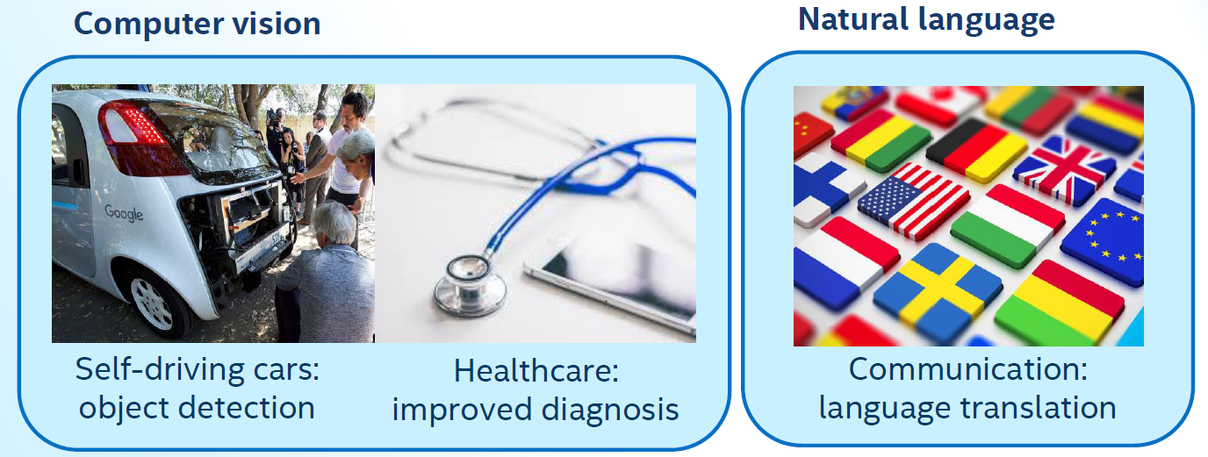
Modern AI (2012 –Present): Deep Learning Impact

Slide 17
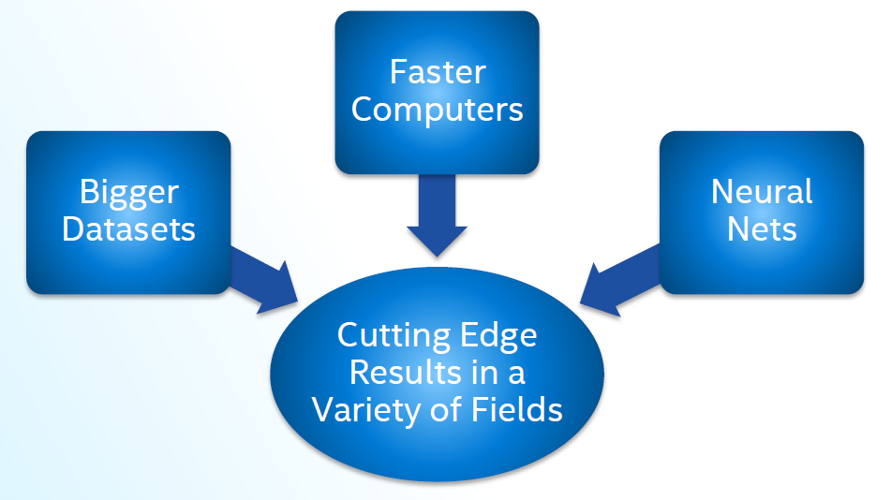
How Is This Era of AI Different?

Slide 18




Modern AI Factors
Continued expansion of open source AI, especially in Python*, aiding machine learning and big data ecosystems.
Leading deep learning libraries open sourced, allowing further adoption by industry.
Open sourcing of large datasets of millions of labeled images, text datasets such as Wikipedia has also driven breakthroughs.
High Performance Computing

Slide 19
Artificial Intelligence Intelligent Systems

Slide 20
What is Intelligence?
The ability of a system to –
calculate,
reason,
perceive relationships and analogies,
learn from experience,
store and retrieve information from memory,
solve problems,
comprehend complex ideas,
use natural language fluently,
classify, generalize, and adapt new situations

Slide 21
Types of Intelligence
As described by Howard Gardner, an American developmental psychologist, the Intelligence comes in multifold −
Intelligence | Description | Example
Linguistic intelligence | The ability to speak, recognize, and use mechanisms of phonology (speech sounds), syntax (grammar), and semantics (meaning). | Narrators, Orators
Musical intelligence | The ability to create, communicate with, and understand meanings made of sound, understanding of pitch, rhythm. | Musicians, Singers, Composers
Logical-mathematical intelligence | The ability of use and understand relationships in the absence of action or objects. Understanding complex and abstract ideas. | Mathematicians, Scientists

Slide 22
Types of Intelligence
Intelligence | Description | Example
Spatial intelligence | The ability to perceive visual or spatial information, change it, and re-create visual images without reference to the objects, construct 3D images, and to move and rotate them. | Map readers, Astronauts, Physicists
Bodily-Kinesthetic intelligence | The ability to use complete or part of the body to solve problems or fashion products, control over fine and coarse motor skills, and manipulate the objects. | Players, Dancers
Intra-personal intelligence | The ability to distinguish among one’s own feelings, intentions, and motivations. | Gautam Buddhha
Interpersonal intelligence | The ability to recognize and make distinctions among other people’s feelings, beliefs, and intentions.

Slide 23
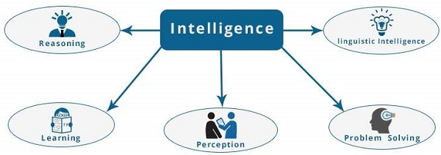
What is Intelligence Composed of?

Slide 24
Reasoning
It is the set of processes that enables us to provide basis for judgement, making decisions, and prediction. There are broadly two types −
Inductive Reasoning | Deductive Reasoning
It conducts specific observations to makes broad general statements. | It starts with a general statement and examines the possibilities to reach a specific, logical conclusion.
Even if all of the premises are true in a statement, inductive reasoning allows for the conclusion to be false. | If something is true of a class of things in general, it is also true for all members of that class.
Example − "Nita is a teacher. Nita is studious. Therefore, All teachers are studious." | Example − "All women of age above 60 years are grandmothers. Shalini is 65 years. Therefore, Shalini is a grandmother."

Slide 25
Learning
It is the activity of gaining knowledge or skill by studying, practising, being taught, or experiencing something. Learning enhances the awareness of the subjects of the study. Learning is categorized as −
Auditory Learning − It is learning by listening and hearing. For example, students listening to recorded audio lectures.
Episodic Learning − To learn by remembering sequences of events that one has witnessed or experienced. This is linear and orderly.
Motor Learning − It is learning by precise movement of muscles. For example, picking objects, Writing, etc.
Observational Learning − To learn by watching and imitating others. For example, child tries to learn by mimicking her parent.

Slide 26
Learning
Perceptual Learning − It is learning to recognize stimuli that one has seen before. For example, identifying and classifying objects and situations.
Relational Learning − It involves learning to differentiate among various stimuli on the basis of relational properties, rather than absolute properties. For Example, Adding ‘little less’ salt at the time of cooking potatoes that came up salty last time, when cooked with adding say a tablespoon of salt.
Spatial Learning − It is learning through visual stimuli such as images, colors, maps, etc. For Example, A person can create roadmap in mind before actually following the road.
Stimulus-Response Learning − It is learning to perform a particular behavior when a certain stimulus is present. For example, a dog raises its ear on hearing doorbell.

Slide 27
Problem Solving
It is the process in which one perceives and tries to arrive at a desired solution from a present situation by taking some path, which is blocked by known or unknown hurdles.
Problem solving also includes decision making, which is the process of selecting the best suitable alternative out of multiple alternatives to reach the desired goal are available.

Slide 28
Perception
It is the process of acquiring, interpreting, selecting, and organizing sensory information.
Perception presumes sensing. In humans, perception is aided by sensory organs. In the domain of AI, perception mechanism puts the data acquired by the sensors together in a meaningful manner.
Linguistic Intelligence
It is one’s ability to use, comprehend, speak, and write the verbal and written language. It is important in interpersonal communication.

Slide 29
Difference between Human &Machine Intelligence
Humans perceive by patterns whereas the machines perceive by set of rules and data.
Humans store and recall information by patterns, machines do it by searching algorithms.
For example, the number 40404040 is easy to remember, store, and recall as its pattern is simple.
Humans can figure out the complete object even if some part of it is missing or distorted; whereas the machines cannot do it correctly.

Slide 30
Artificial Intelligence Applications / Research Areas

Slide 31
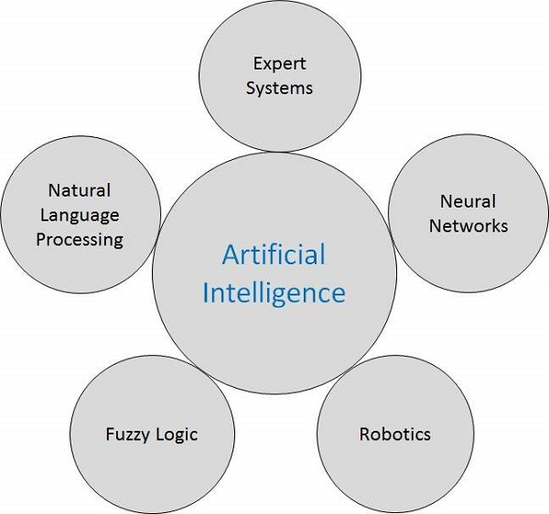

Slide 32



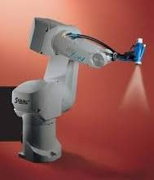
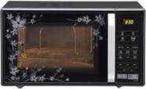
Some Real Life Applications
Sr.No. | Applications / Research Areas | Real Life Application
1 | Expert Systems Examples − Flight-tracking systems, Clinical systems.
2 | Natural Language Processing Examples: Google Now feature, speech recognition, Automatic voice output.
3 | Neural Networks Examples − Pattern recognition systems such as face recognition, character recognition, handwriting recognition.
4 | Robotics Examples − Industrial robots for moving, spraying, painting, precision checking, drilling, cleaning, coating, carving, etc.
5 | Fuzzy Logic Systems Examples − Consumer electronics, automobiles, etc.

Slide 33
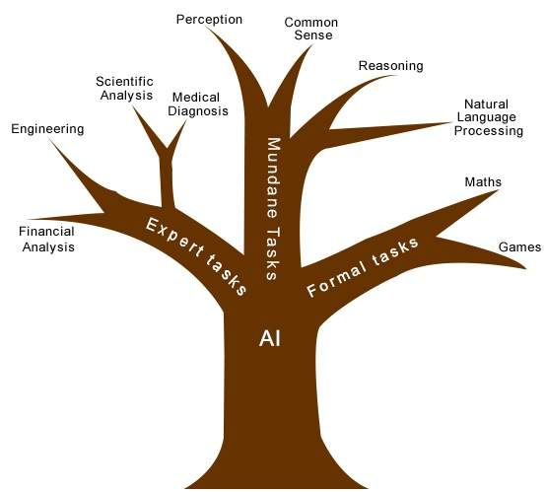
Task Classification of AI
The domain of AI is classified into Formal tasks, Mundane tasks, and Expert tasks.

Slide 34
Task Domains of Artificial Intelligence
Mundane (Ordinary) Tasks | Formal Tasks | Expert Tasks
Perception Computer Vision Speech, Voice | Mathematics Geometry Logic Integration and Differentiation | Engineering Fault Finding Manufacturing Monitoring
Natural Language Processing Understanding Language Generation Language Translation | Games Go Chess (Deep Blue) Ckeckers | Scientific Analysis
Common Sense | Verification | Financial Analysis
Reasoning | Theorem Proving | Medical Diagnosis
Planing |  | Creativity
Robotics

Slide 35
Humans learn mundane (ordinary) tasks since their birth.
They learn by perception, speaking, using language, and locomotives.
They learn Formal Tasks and Expert Tasks later, in that order.
For humans, the mundane tasks are easiest to learn.
The same was considered true before trying to implement mundane tasks in machines.
Earlier, all work of AI was concentrated in the mundane task domain.
Later, it turned out that the machine requires more knowledge, complex knowledge representation, and complicated algorithms for handling mundane tasks.
This is the reason why AI work is more prospering in the Expert Tasks domain now, as the expert task domain needs expert knowledge without common sense, which can be easier to represent and handle.

Slide 36
Artificial Intelligence Agents & Environments

Slide 37
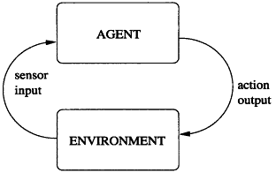
Agent and Environment
An AI system is composed of an agent and its environment.
The agents act in their environment.
The environment may contain other agents.

Slide 38
What are Agents and Environment?
An agent is anything that can perceive its environment through sensors and acts upon that environment through effectors.
A human agent has sensory organs such as eyes, ears, nose, tongue and skin parallel to the sensors, and other organs such as hands, legs, mouth, for effectors.
A robotic agent replaces cameras and infrared range finders for the sensors, and various motors and actuators for effectors.
A software agent has encoded bit strings as its programs and actions.

Slide 39
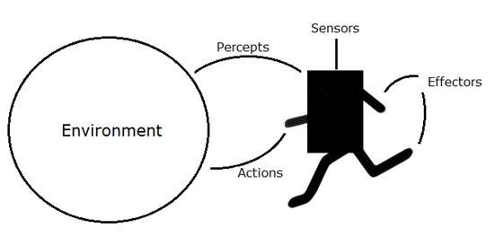

Slide 40
Agent Terminology
Performance Measure of Agent − It is the criteria, which determines how successful an agent is.
Behavior of Agent − It is the action that agent performs after any given sequence of percepts.
Percept − It is agent’s perceptual inputs at a given instance.
Percept Sequence − It is the history of all that an agent has perceived till date.
Agent Function − It is a map from the precept sequence to an action.

Slide 41
What is an Ideal Agent?
An ideal agent is the one, which is capable of doing expected actions to maximize its performance measure, on the basis of −
Its percept sequence
Its built-in knowledge base
Rationality of an agent depends on the following −
The performance measures, which determine the degree of success.
Agent’s Percept Sequence till now.
The agent’s prior knowledge about the environment.
The actions that the agent can carry out.

Slide 42
Rationality
Rationality is nothing but status of being reasonable, sensible, and having good sense of judgment.
Rationality is concerned with expected actions and results depending upon what the agent has perceived.
A rational agent always performs right action, where the right action means the action that causes the agent to be most successful in the given percept sequence.
The problem the agent solves is characterized by Performance Measure, Environment, Actuators, and Sensors (PEAS).

Slide 43
The Structure of Intelligent Agents
Agent’s structure can be viewed as −
Agent = Architecture + Agent Program
Architecture = the machinery that an agent executes on.
Agent Program = an implementation of an agent function.
Simple Reflex Agents
They choose actions only based on the current percept.
They are rational only if a correct decision is made only on the basis of current precept.
Their environment is completely observable.

Slide 44
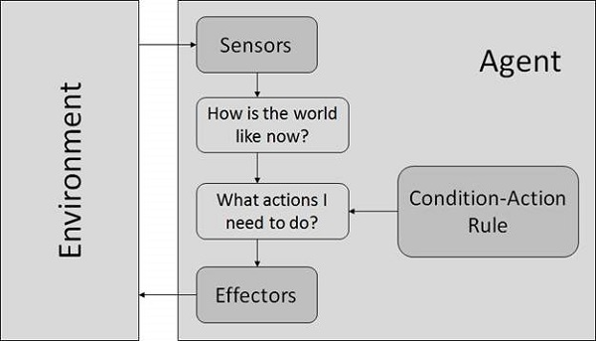
Condition-Action Rule It is a rule that maps a state (condition) to an action.

Slide 45
Properties of Environment
Discrete / Continuous − If there are a limited number of distinct, clearly defined, states of the environment, the environment is discrete (For example, chess); otherwise it is continuous (For example, driving).
Observable / Partially Observable − If it is possible to determine the complete state of the environment at each time point from the percepts it is observable; otherwise it is only partially observable.
Static / Dynamic − If the environment does not change while an agent is acting, then it is static; otherwise it is dynamic.
Single agent / Multiple agents − The environment may contain other agents which may be of the same or different kind as that of the agent.

Slide 46
Accessible / Inaccessible − If the agent’s sensory apparatus can have access to the complete state of the environment, then the environment is accessible to that agent.
Deterministic / Non-deterministic − If the next state of the environment is completely determined by the current state and the actions of the agent, then the environment is deterministic; otherwise it is non-deterministic.
Episodic / Non-episodic − In an episodic environment, each episode consists of the agent perceiving and then acting. The quality of its action depends just on the episode itself. Subsequent episodes do not depend on the actions in the previous episodes. Episodic environments are much simpler because the agent does not need to think ahead.

Slide 47
Artificial Intelligence Search Techniques /Algorithms

Slide 48

What is Search?
Searching is the universal technique of problem solving in AI.
The search Techniques gives desired unique solution.
For eg. There are some single-player games such as tile games, Sudoku, crossword, etc. The search algorithms help you to search for a particular position in such games.

Slide 49
Search Terminology
Problem Space − It is the environment in which the search takes place. (A set of states and set of operators to change those states)
Problem Instance − It is Initial state + Goal state.
Problem Space Graph − It represents problem state. States are shown by nodes and operators are shown by edges.
Depth of a problem − Length of a shortest path or shortest sequence of operators from Initial State to goal state.

Slide 50
Search Terminology
Space Complexity − The maximum number of nodes that are stored in memory.
Time Complexity − The maximum number of nodes that are created.
Admissibility − A property of an algorithm to always find an optimal solution.
Branching Factor − The average number of child nodes in the problem space graph.
Depth − Length of the shortest path from initial state to goal state.

Slide 51
Search Techniques
Uninformed
(Blind) Search
Breadth First Search
Depth First Search
Informed
(Heuristic) Search
Pure Heuristic Search
Uniform Cost Search
A * Search
Greedy Best First Search

Slide 52
Un-informed (Blind) Search Techniques
The uninformed search does not contain any domain knowledge such as closeness, the location of the goal.
It operates in a brute-force way as it only includes information about how to traverse the tree and how to identify goal nodes.
Uninformed search applies a way in which search tree is searched without any information about the search space, so it is also called blind search.
It examines each node of the tree until it achieves the goal node.
For eg: Depth First search, Breadth First Search, Uniform Cost Search

Slide 53
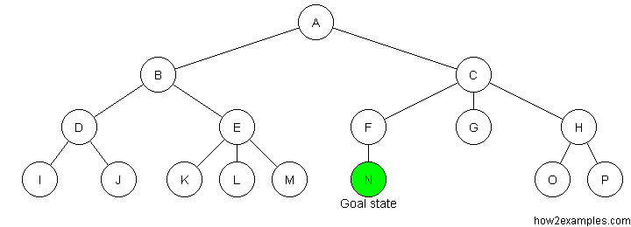
Requirements −
State description
A set of valid operators
Initial state
Goal state description

Slide 54
Informed (Heuristic) Search
Informed search algorithms use domain knowledge, i.e., problem information is available which can guide the search.
Informed search strategies can find a solution more efficiently than an uninformed search strategy.
A heuristic is a way which might not always be guaranteed for best solutions but guaranteed to find a good solution in reasonable time.
Informed search can solve much complex problem which could not be solved in another way.
For eg: Pure heuristic search, A* Search, Greedy Search

Slide 55
Breadth-first Search:
Breadth-first search is the most common search strategy for traversing a tree or graph.
This algorithm searches breadth-wise in a tree or graph, so it is called breadth-first search.
BFS algorithm starts searching from the root node of the tree and expands all successor node at the current level before moving to nodes of next level.
The breadth-first search algorithm is an example of a general-graph search algorithm.
Breadth-first search implemented using FIFO queue data structure.

Slide 56
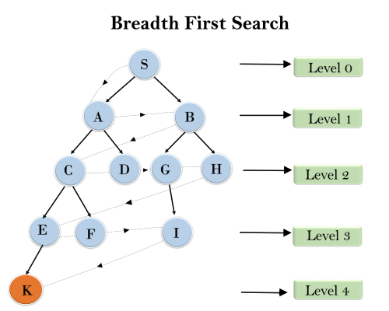

Slide 57
Time Complexity: Time Complexity of BFS algorithm can be obtained by the number of nodes traversed in BFS until the shallowest Node.
If branching factor (average number of child nodes for a given node) = b and depth = d, then number of nodes at level d = b^{d}.
The total no of nodes created in worst case is b + b² + b³ + … + b^{d}.
Space Complexity: Space complexity of BFS algorithm is given by the Memory size of frontier which is (b^{d}).
Completeness: BFS is complete, which means if the shallowest goal node is at some finite depth, then BFS will find a solution.
Optimality: BFS is optimal if path cost is a non-decreasing function of the depth of the node.

Slide 58
Advantages:
BFS will provide a solution if any solution exists.
If there are more than one solutions for a given problem, then BFS will provide the minimal solution which requires the least number of steps.
Disadvantages:
It requires lots of memory since each level of the tree must be saved into memory to expand the next level.
BFS needs lots of time if the solution is far away from the root node.

Slide 59
Depth-first Search:
Depth-first search is a recursive algorithm for traversing a tree or graph data structure.
It is called the depth-first search because it starts from the root node and follows each path to its greatest depth node before moving to the next path.
The process of the DFS algorithm is similar to the BFS algorithm.
It is implemented in recursion with LIFO stack data structure. It creates the same set of nodes as Breadth-First method, only in the different order.

Slide 60
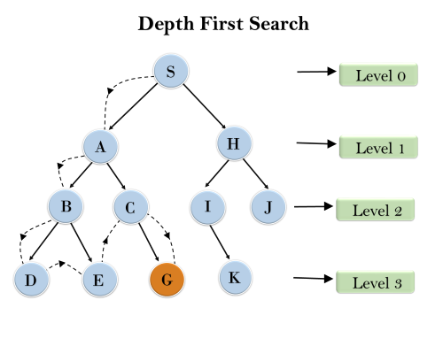

Slide 61
Completeness: DFS search algorithm is complete within finite state space as it will expand every node within a limited search tree.
Time Complexity: Time complexity of DFS will be equivalent to the node traversed by the algorithm. It is given by:
T(n)= 1+ n²+ n³ +.........+ n^{m}
Where, m= maximum depth of any node and this can be much larger than d (Shallowest solution depth)
Space Complexity: DFS algorithm needs to store only single path from the root node, hence space complexity of DFS is equivalent to the size of the fringe set, which is (b^{m}).
Optimal: DFS search algorithm is non-optimal, as it may generate a large number of steps or high cost to reach to the goal node.

Slide 62
Advantages:
DFS requires very less memory as it only needs to store a stack of the nodes on the path from root node to the current node.
It takes less time to reach to the goal node than BFS algorithm (if it traverses in the right path).
Disadvantages:
There is the possibility that many states keep re-occurring, and there is no guarantee of finding the solution.
DFS algorithm goes for deep down searching and sometime it may go to the infinite loop.

Slide 63
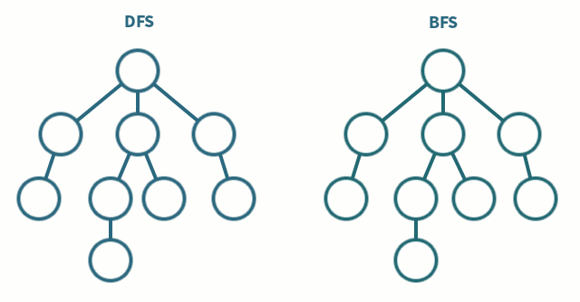

Slide 64
Uniform Cost Search:
Uniform-cost search is a searching algorithm used for traversing a weighted tree or graph, play when a different cost is available for each edge.
The primary goal of the uniform-cost search is to find a path to the goal node which has the lowest cumulative cost.
Uniform-cost search expands nodes according to their path costs from the root node. It can be used to solve any graph/tree where the optimal cost is in demand.
A uniform-cost search algorithm is implemented by the priority queue. It gives maximum priority to the lowest cumulative cost.
Uniform cost search is equivalent to BFS algorithm if the path cost of all edges is the same.

Slide 65
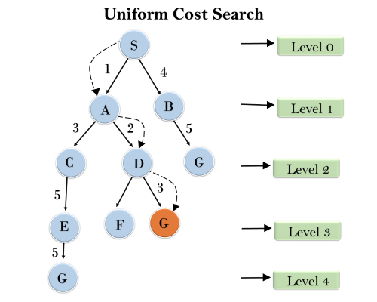

Slide 66
Completeness:
Uniform-cost search is complete, such as if there is a solution, UCS will find it.
Time Complexity:
Let C* is Cost of the optimal solution, and ε is each step to get closer to the goal node. Then the number of steps is = C*/ε+1. Here we have taken +1, as we start from state 0 and end to C*/ε.
Hence, the worst-case time complexity of Uniform-cost search is (b^{1 + [C*/ε]})/.
Space Complexity:
The same logic is for space complexity so, the worst-case space complexity of Uniform-cost search is (b^{1 + [C*/ε]}).
Optimal:
Uniform-cost search is always optimal as it only selects a path with the lowest path cost.

Slide 67
Advantages:
Uniform cost search is optimal because at every state the path with the least cost is chosen.
Disadvantages:
It does not care about the number of steps involve in searching and only concerned about path cost.
Due to which this algorithm might get stuck in an infinite loop.

Slide 68
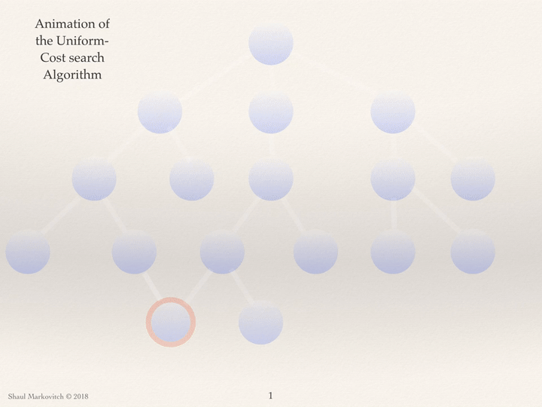

Slide 69
Comparison of Various Algorithms Complexities
Let us see the performance of uninformed algorithms based on various criteria −
Criterion | Breadth First | Depth First | Uniform Cost
Time | b^{d} | b^{m} | b^{d}
Space | b^{d} | b^{m} | b^{d}
Optimality | Yes | No | Yes
Completeness | Yes | No | Yes

Slide 70
Pure Heuristic Search
It expands nodes in the order of their heuristic values.
It creates two lists, a closed list for the already expanded nodes and an open list for the created but unexpanded nodes.
In each iteration, a node with a minimum heuristic value is expanded, all its child nodes are created and placed in the closed list.
Then, the heuristic function is applied to the child nodes and they are placed in the open list according to their heuristic value.
The shorter paths are saved and the longer ones are disposed.

Slide 71
A * Search
It is best-known form of Best First search.
It avoids expanding paths that are already expensive, but expands most promising paths first.
f(n) = g(n) + h(n),
Where, g(n) the cost (so far) to reach the node
h(n) estimated cost to get from the node to the goal
f(n) estimated total cost of path through n to goal. It is implemented using priority queue by increasing f(n).

Slide 72
Greedy Best First Search
It expands the node that is estimated to be closest to goal.
It expands nodes based on f(n) = h(n).
It is implemented using priority queue.
Disadvantage − It can get stuck in loops. It is not optimal.

Slide 73
Artificial Intelligence AI vs ML vs DL

Slide 74
Definitions
Artificial Intelligence
A program that can sense, reason, act and adopt
▪Artificial Intelligence
▪Machine Learning
▪Deep Learning
Machine Learning
Algorithms whose performance increases over the time
Deep Learning
Subset of Ml in which multi layered neural networks learn from vast amount of data
Notes:
AI- to handle unforeseem circumstances. BOSTON DYNAMICS VIDEO
Unstructured data, ML- structured.
AI is often used interchangeably with ML is because it’s not always straightforward to know whether the underlying data is structured or unstructured.

Slide 75
Machine Learning
“The process by which a computer is able to improve its own performance (as in analyzing image files) by continuously incorporating new data into an existing statistical model”
“Building algorithms that allow computers to develop new behaviors based on experience” — Adam Piore
Notes:
ml:
-data: get a lot of cleaned data. is this email a spam? age, height etc.
- training: use data to tune relative significant features
- inference: predict something new

Slide 76
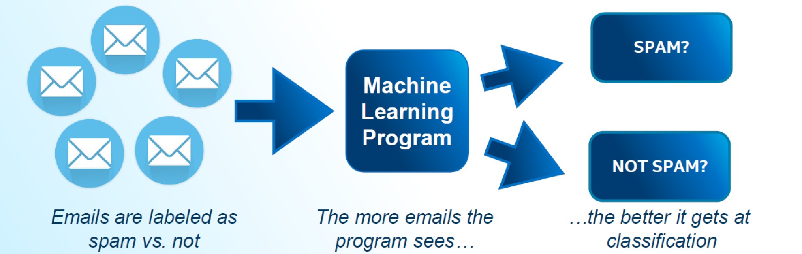
Machine Learning
These programs learn from repeatedly seeing data, rather than being explicitly programmed by humans.

Slide 77

Machine Learning Example
Suppose you wanted to identify fraudulent credit card transactions.
You could define features to be:
Transaction time
Transaction amount
Transaction location
Category of purchase
The algorithm could learn what feature combinations suggest unusual activity.

Slide 78
Deep Learning
Deep learning is the sub-field of machine learning focused on developing algorithms consisting of multilayer artificial neural networks inspired by human brain structure called neurons.
“Machine learning that involves using very complicated models called “deep neural networks”." (Intel)
Models determine best representation of original data; in classic machine learning, humans must do this.

Slide 79
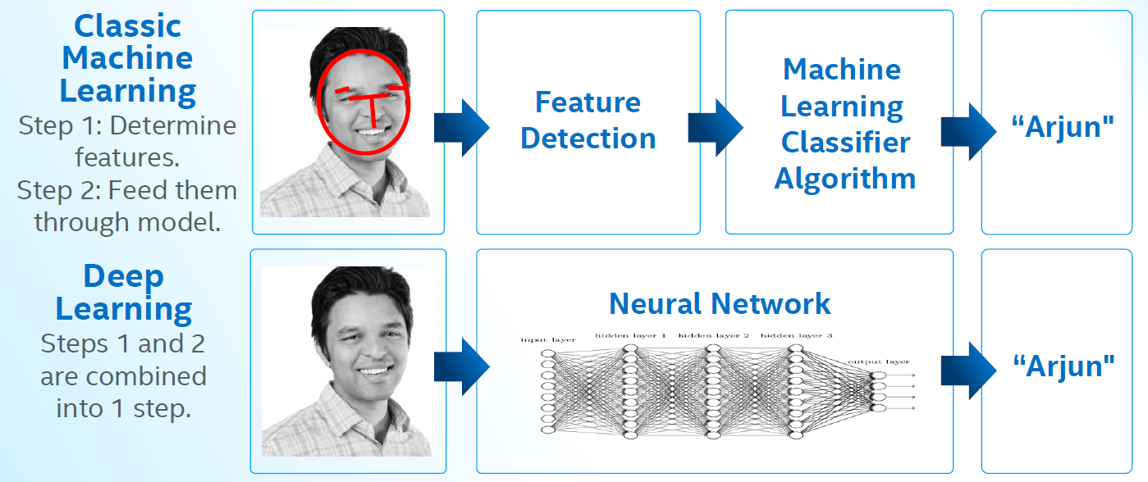
Deep Learning Example

Slide 80

Machine Learning Classification

Slide 81
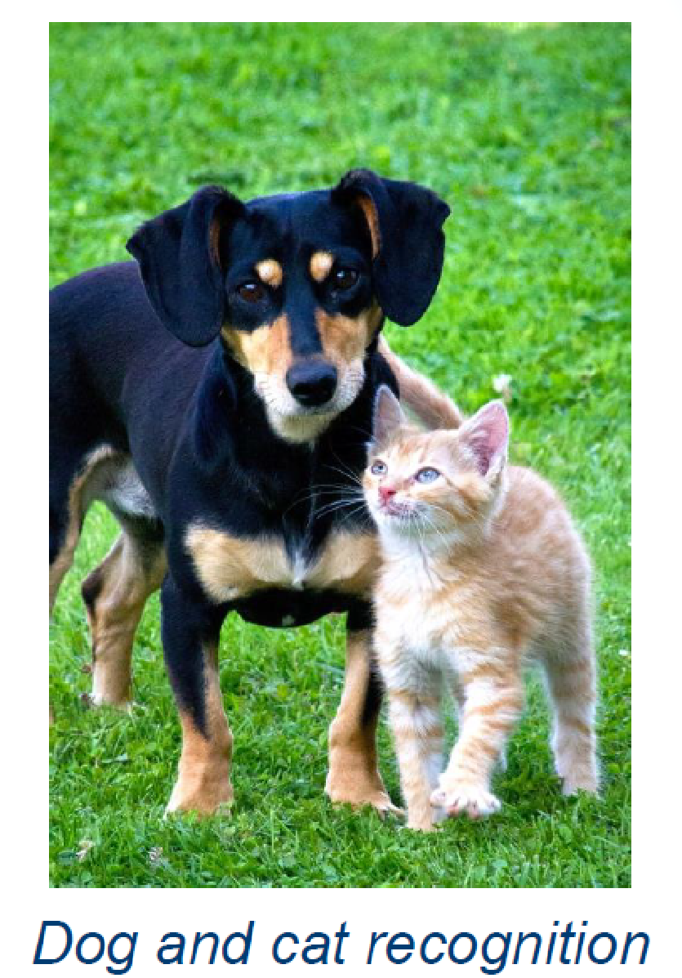
Machine Learning Limitations
Suppose you wanted to determine if an image is of a cat or a dog.
What features would you use?
This is where Deep Learning can come in.

